Slide 1
ETP Presentation
Common Grammar and Spelling Mistakes in Public Places

Slide 2
Team Members
Madhav Goyal (2011981262)
Akhilesh Thakur (2111981020)
Akshita (2111981026)
Anjori (2111981033)

Slide 3
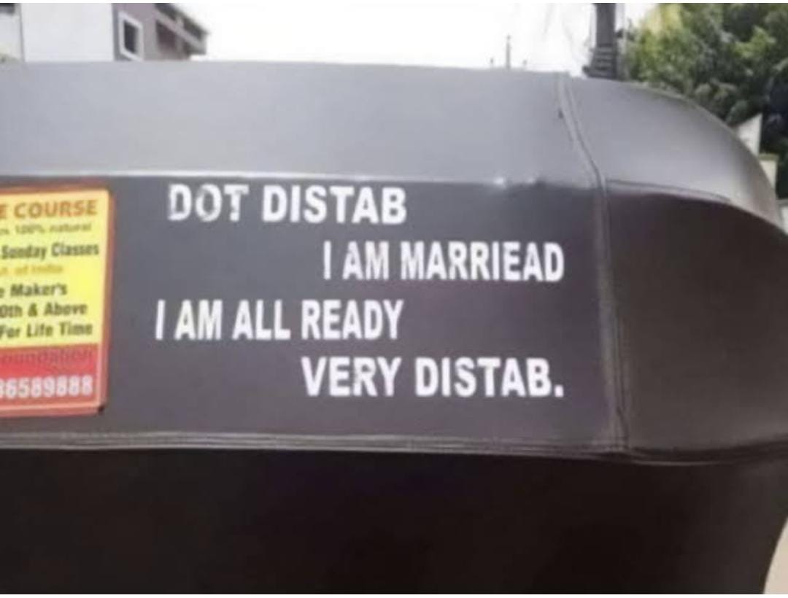
Poor Grammar and Spelling Mistakes
Correct:
DON’T DISTURB.
I AM MARRIED.
I AM ALREADY VERY DISTURBED.

Slide 4
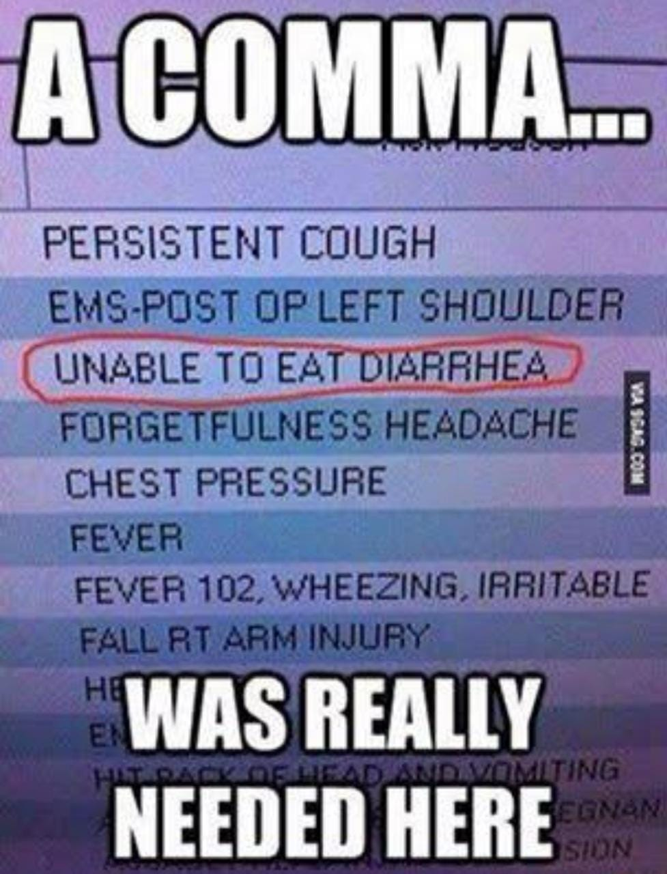
Missing Comma
Missing Comma completely changed the meaning of the phrase

Slide 5
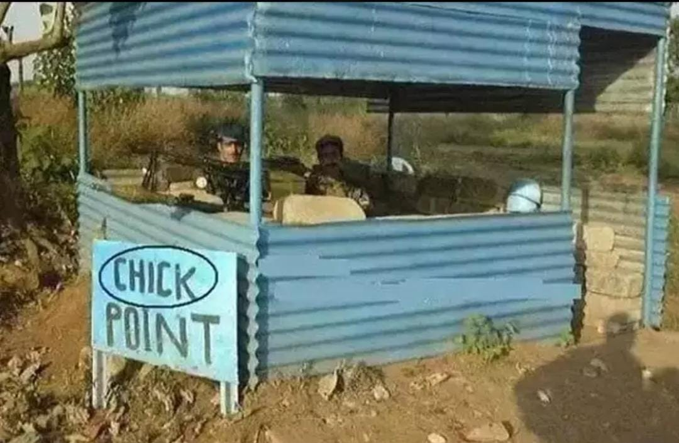
Spelling Mistake
Correct:
CHECK POINT

Slide 6
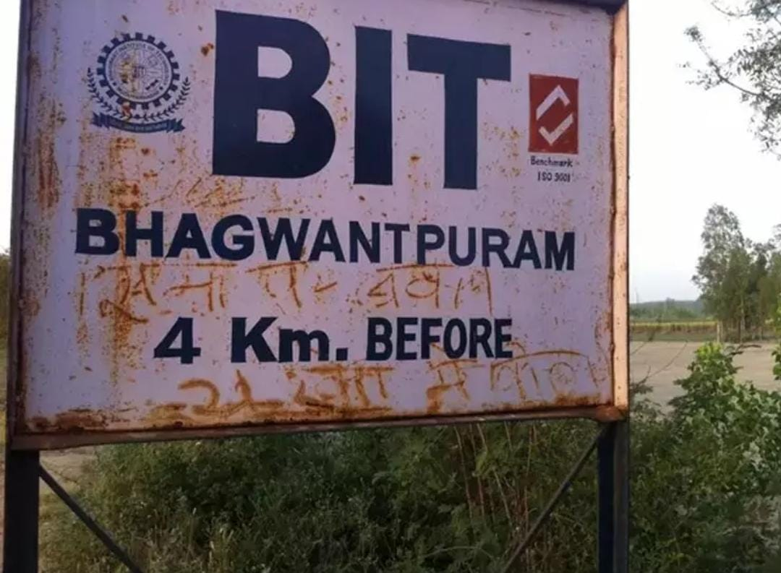
Poor Grammar
So unclear that we have no idea what they meant

Slide 7
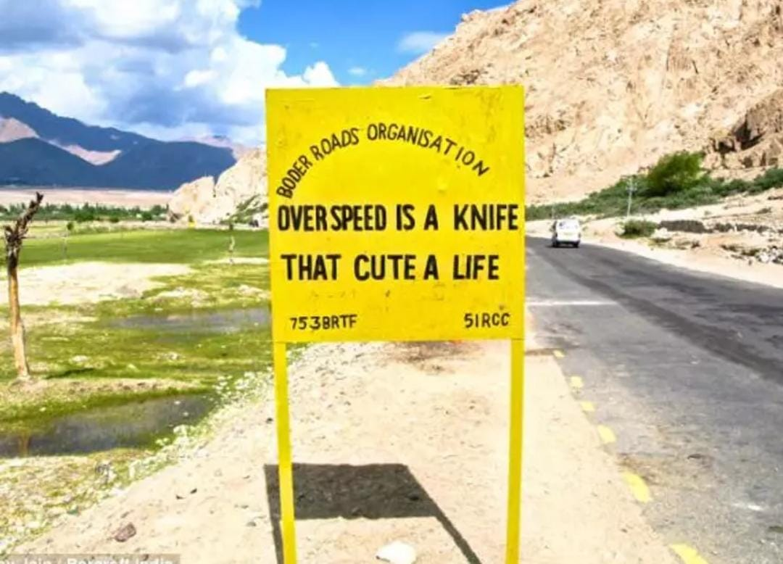
Poor Grammar and Vocabulary
Correct:
OVERSPEEDING IS LIKE A KNIFE
THAT CUTS A LIFE

Slide 8
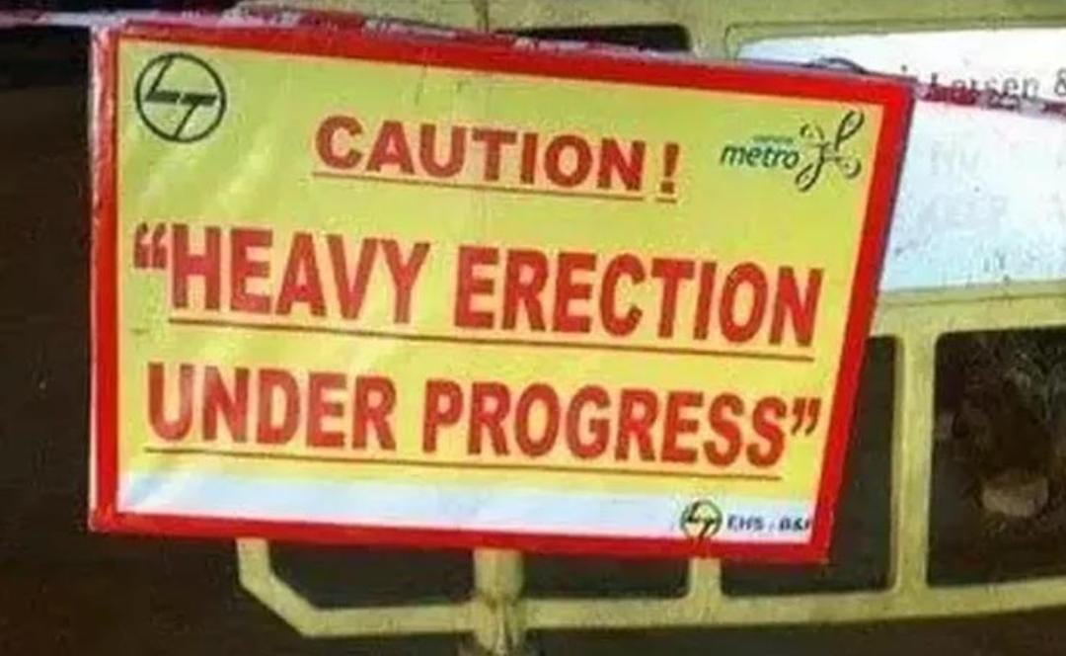
Serious Spelling Mistake
Construction
->
Erection

Slide 9
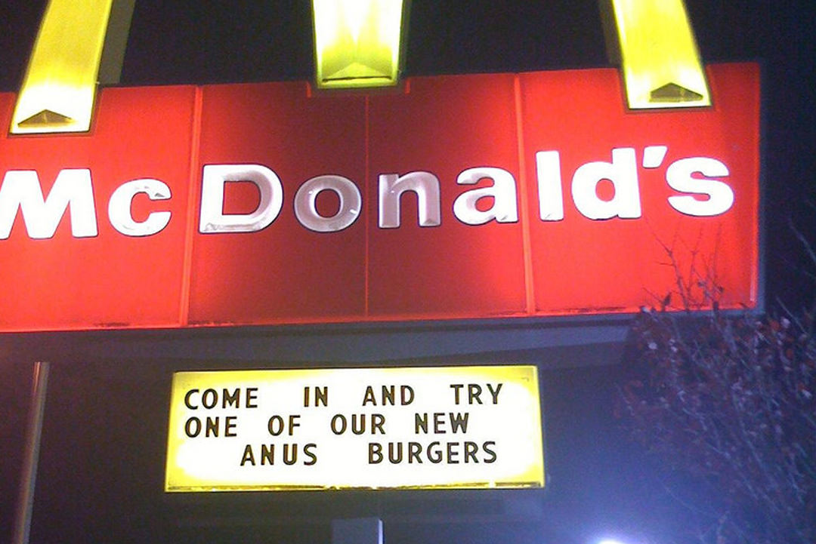
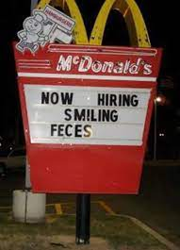
McDonald’s lovin’ it

